Slide 4
Paul R Christen High Adventure Base
Notes:
The Christen National High Adventure Base began operations in June 2014 with programs focused on action sports. Programs run Sundays to Saturdays. Participants camp in the Christen High Adventure Base camp at the Summit. For those of you who may have attended the Jamboree, that is basecamps Alpha and Bravo. Programs include opportunities for council contingents, individual troops, teams and crews, and individual Scouts and Venturers attending as provisional participants.
Let’s talk about the programs that are part of the high adventure program.

Slide 5
Notes:
The Summit Experience gives you the full range of the high adventure capabilities available at the Summit. Ten different activities provide a wide variety of experiences, including climbing and rappelling, challenge courses, canopy tour, rifle and shotgun, archery, skateboarding, mountain biking, service project and BMX. And of course, everybody rides the 3,200 ft. Big Zip. For units with a wide variety of interests, this is your program.

Slide 6
Notes:
Focused programs allow for a deeper dive into a certain type of activity while still allowing participants to experience the variety of activities that the Summit has to offer.
3 days in your focused activity, 2 half day electives, a service project and a ride on the big zip are included.

Slide 8
Notes:
The Extended Trail Corps is a provisional only program. Individual Scouts or Venturers register and we form them into a crew upon arrival. Participants will get a week of trail building and a week in the Summit Experience Program. This version of the Summit Experience Program is a little beefed up and includes a full day of whitewater rafting and rock climbing in the New River Gorge.

Slide 11
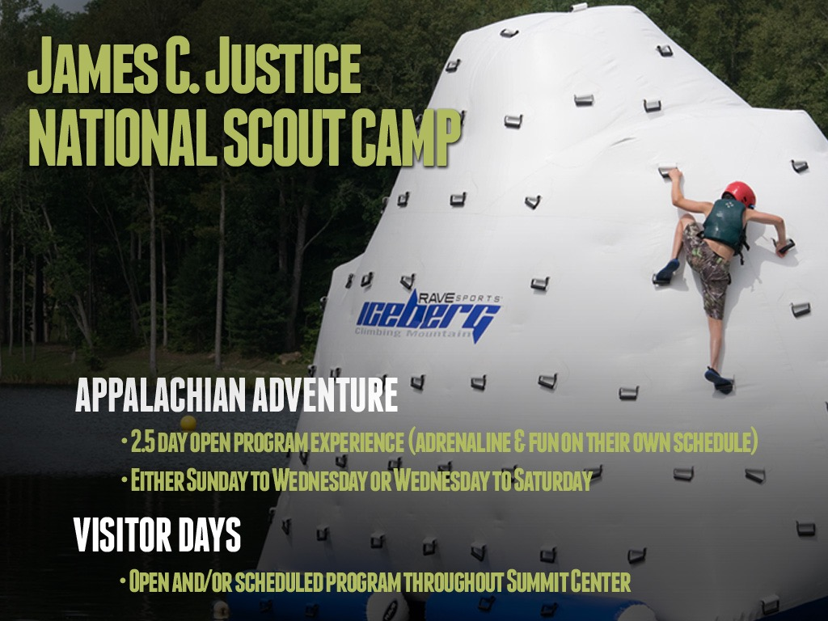

Slide 12
Notes:
NOTES: The Summit Bechtel Reserve will be introducing the John D. Tickle National Training and Leadership Center in June 2016. We will be offering seven-day, five-day and weekend conferences through the end of July.

Slide 13
Notes:
These National Training Conferences focus on learning based development for all levels of volunteers and professionals within the BSA. A full list of course offerings, with dates and pricing, are listed on the Training Center handout that we will give you at the end of this presentation. Please register soon as most of these conferences have limited capacity.

Slide 14
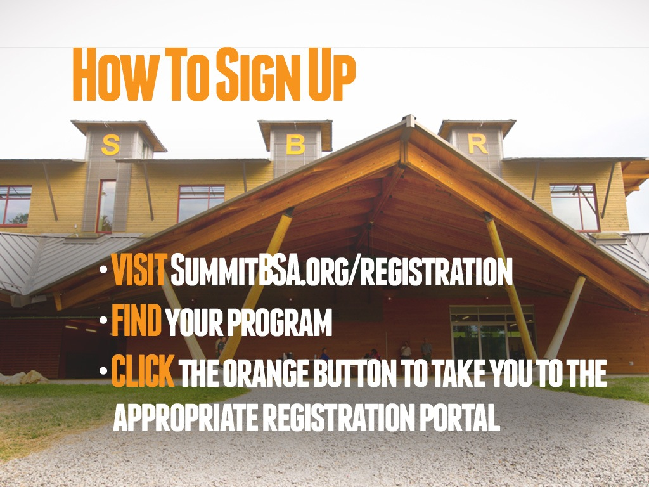
Notes:
Head over to summithighadventure.org to explore the programs with your group.
Download the program fact sheets, watch the videos and check out the brochure at the Marketing Toolkit page.
When you’re ready to register, you can download the registration instructions and appropriate forms from there as well.
The Summit has so much to offer, we’ve made it easy for just about anyone to register for these programs. The Summit is still accepting reservations for the 2014 season. The Summit is conveniently located within a days drive for many of the councils in the Northeast, Central and Southern Regions. For those who live a little further away, we are minutes from the closest train station and just about an hour away from Charleston’s Yeager Airport.

Slide 15
