Slide 1
Summit Adventure Trek
[Camp/Council Name or Logo]

Slide 2
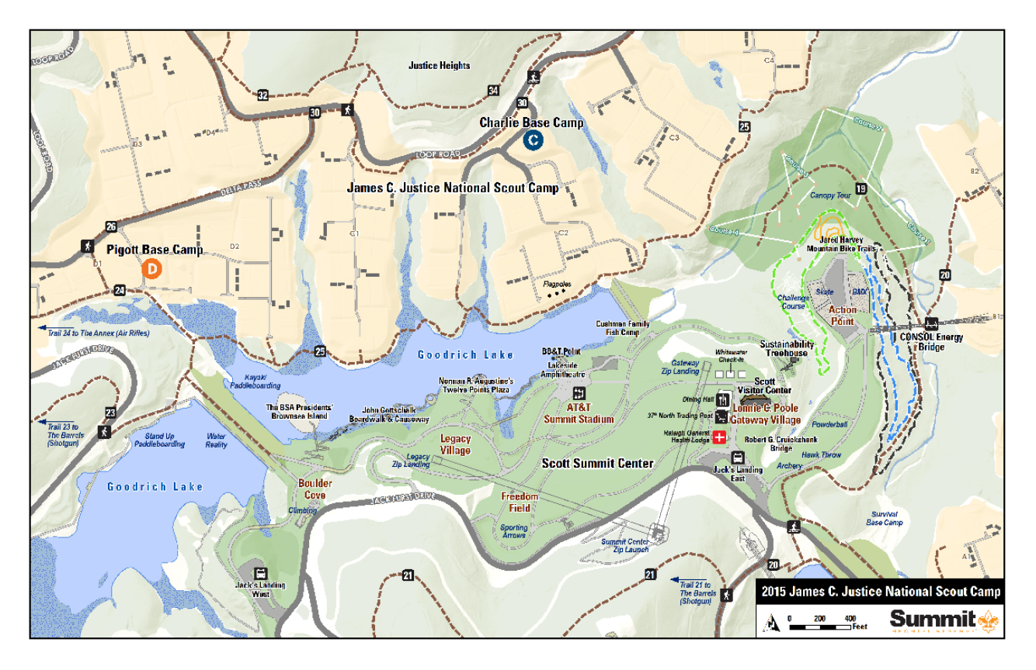
The Scott Summit Center & James C. Justice National Scout Camp

Slide 3
Scott Summit Center & The James C. Justice National Scout Camp

Slide 4
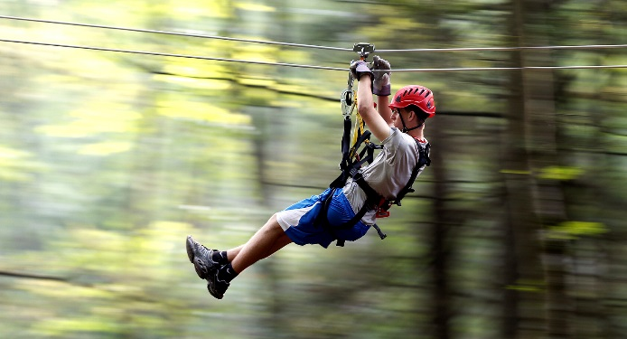
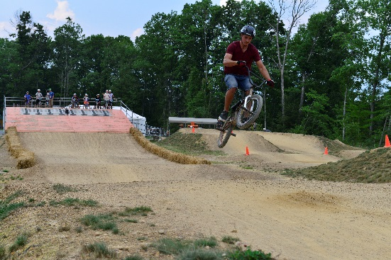
Action Point
Challenge Course
Canopy Tours
BMX Race Tracks
Skate Park
Jared Harvey Mountain Bike Trails
CONSOL Energy Bridge

Slide 5
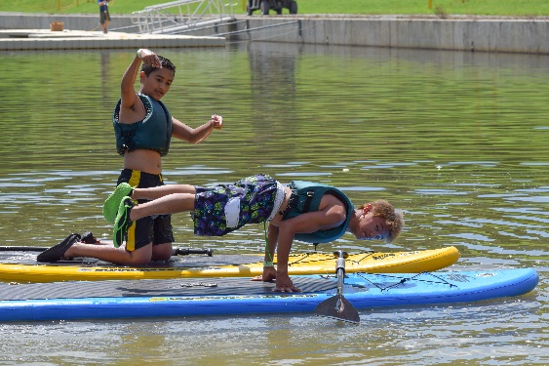
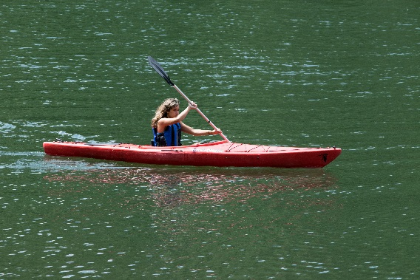
Goodrich Lake
Kayaking
Paddleboarding
Water Obstacle Course
Fishing
Gottschalk Boardwalk
Brownsea Island

Slide 6
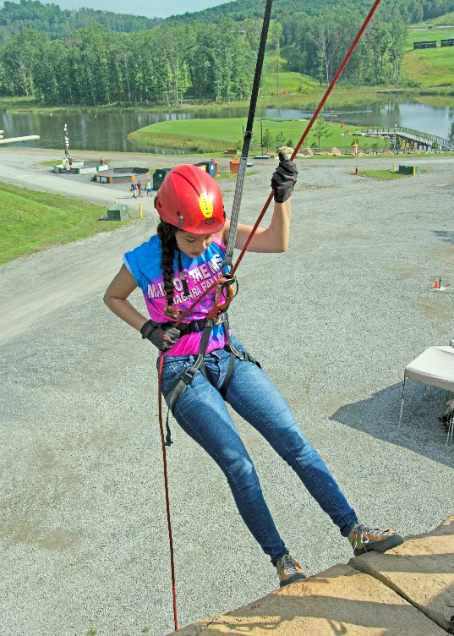
Boulder Cove
Climbing
Rappelling
Bouldering
Ga-ga Ball

Slide 7
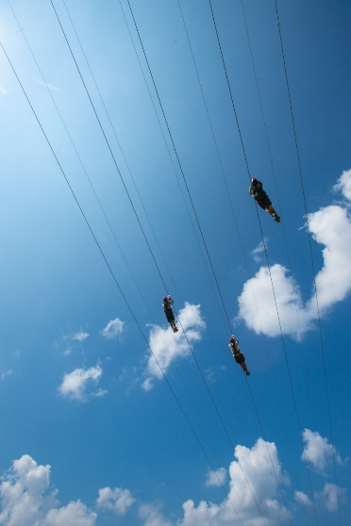
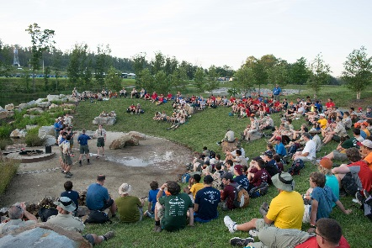
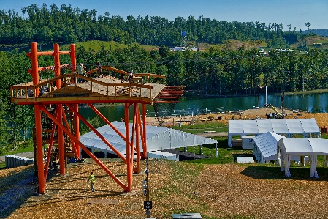
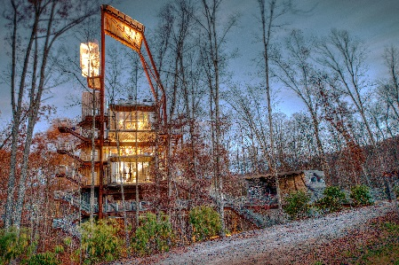
Gateway & Legacy Villages
Summit Center Zip Lines
Sustainability Treehouse
37° North Outfitters
BB&T Point
AT&T Summit Stadium
Scott Visitor Center

Slide 8
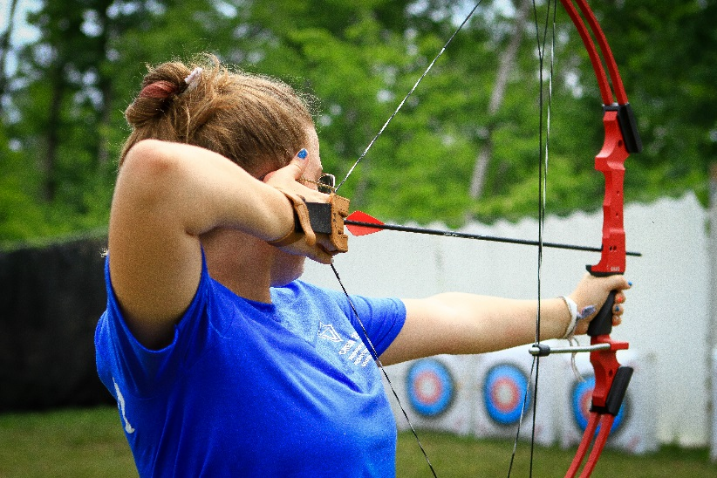
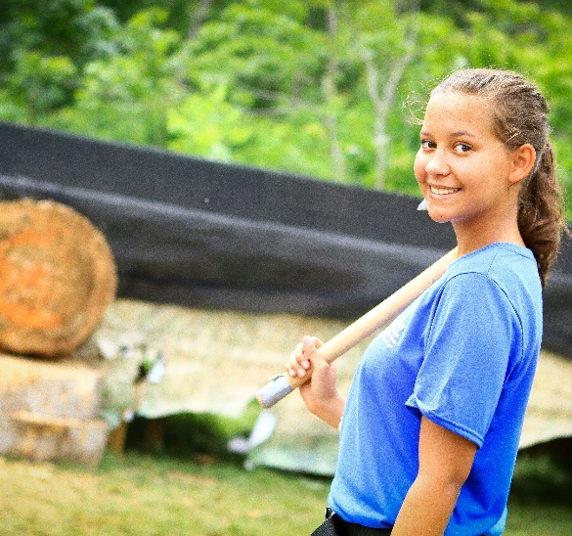
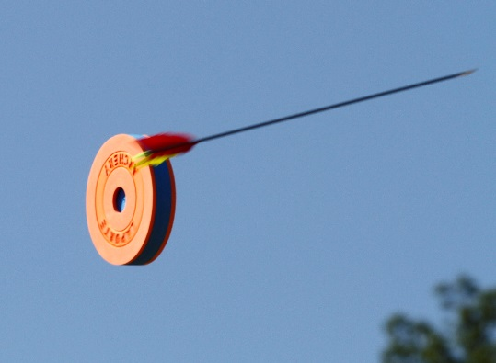
Shooting Sports Annex
Rifle Shooting
Static Archery
LaPorte (Sporting Arrows)
Tomahawk & Knife Throwing

Slide 9
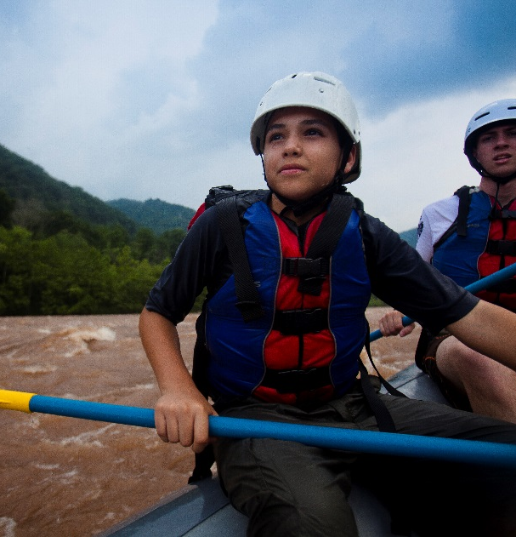
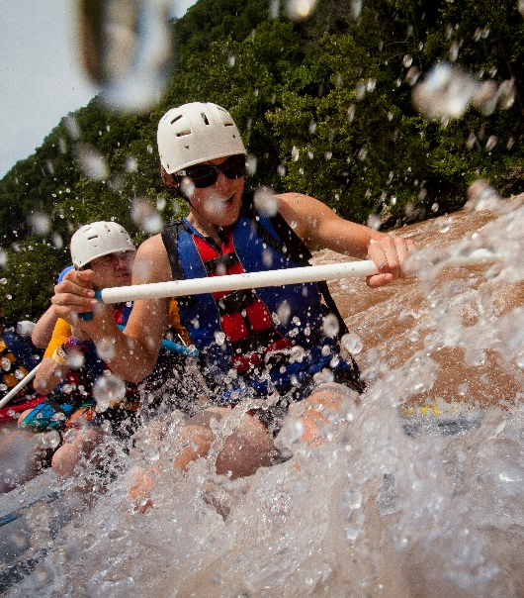
New River Gorge Rafting Trip
Lower New River
Class IV & V Rapids
½ Day

Slide 10
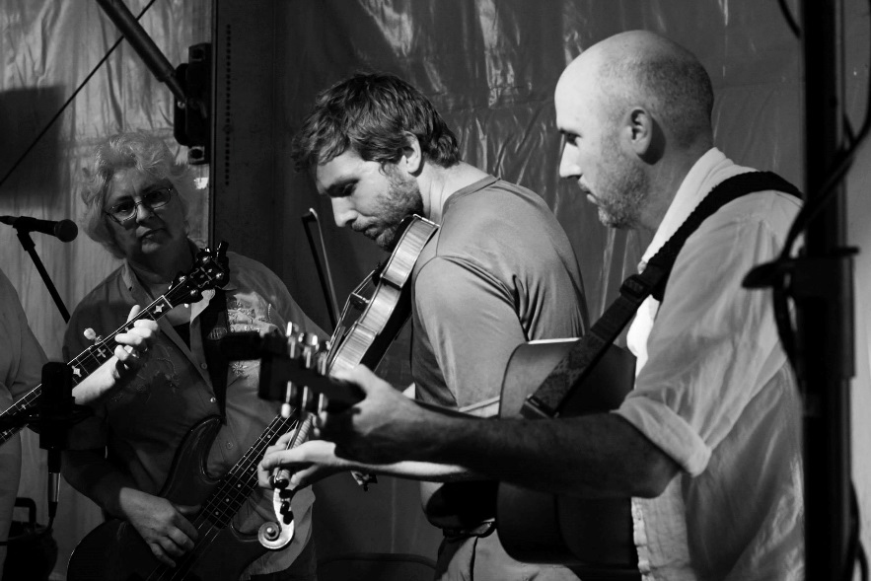
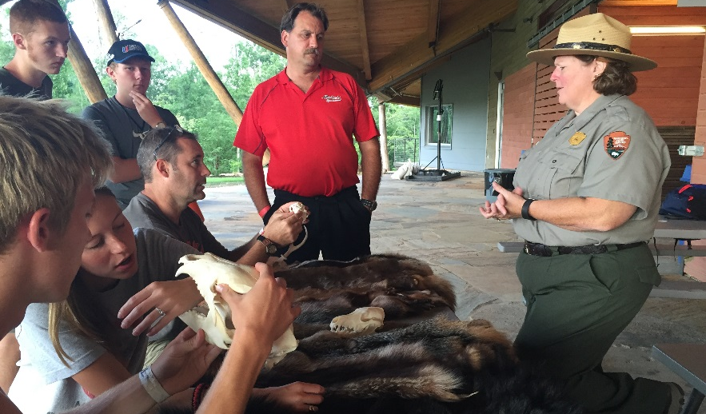
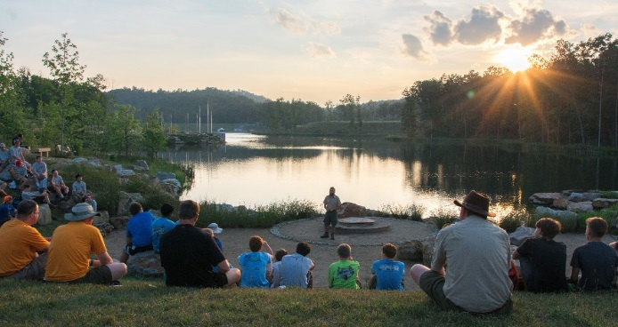
Camp-Wide Activities
Appalachian “Celebrachian”
Competitions & Special Events
Flag Ceremonies
Cook-Offs
International Showcase & Campfire
Flag Retirement Ceremony
National Park Service Presentations

Slide 11
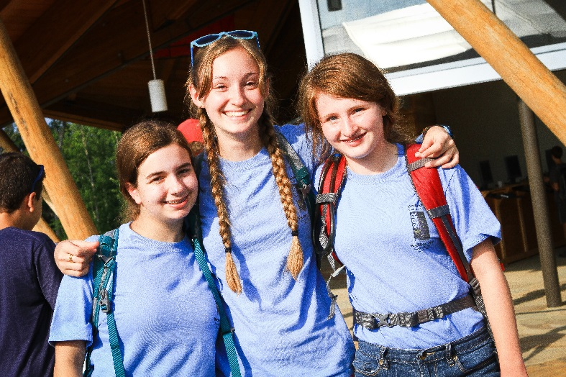
Venturing Advancement Opportunities
Ranger Elective Requirements
Project COPE
Mountaineering
Ecology
Plants & Wildlife
Shooting Sports (Archery or Rifle)
Cycling
Fishing
Ranger Core Requirements
Land Navigation
Leave No Trace
Wilderness Survival
Conservation

Slide 12
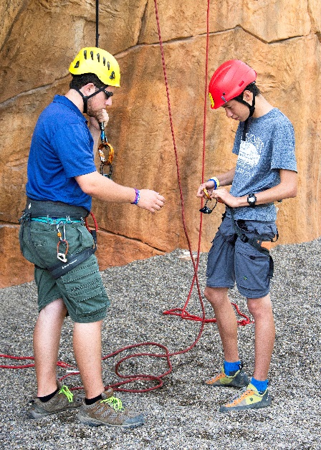
Boy Scout Advancement Opportunities
Merit Badges
Kayaking
Fishing/Fly-Fishing
Fish & Wildlife Management
Orienteering/Geocaching
Climbing
Archery
Rifle Shooting
Shotgun Shooting
Wilderness Survival
Search & Rescue
Astronomy
Cycling
Sustainability
Nature
Forestry
Mammal/Bird Study
Environmental Science
Soil & Water Conservation/Gardening
Pioneering
Photography
Other Awards
Kayaking BSA
BSA Stand Up Paddleboarding Award
Summit Shredder Award
Complete Angler Award

Slide 13
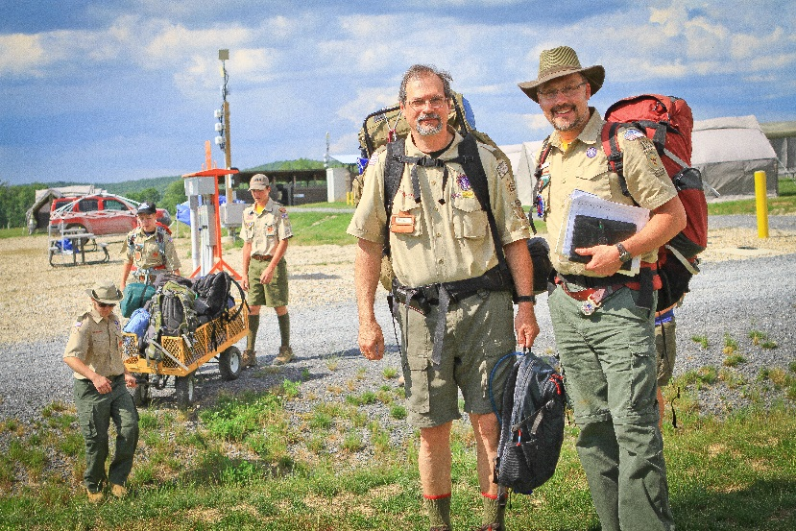
Training Opportunities
Program Specific
Swiftwater Rescue (16+)
Paddlecraft Safety (15+)
Swimming & Water Rescue (15+)
Leave No Trace Awareness
Leave No Trace Trainer
Climbing Instructor Level 1 (18+)
Climbing Instructor In Training (16+)
Adult Leader
Position Specific (SM, Advisor, etc)
Outdoor Leader Skills
Troop/Crew Committee Challenge
Youth Protection Recertification

Slide 14
Camping Facilities
Equipment/Facilities Provided
Dome Tents
Cots
Dining Flies
Picnic Tables
Above-Ground Fire Pit
“Ambient-Temperature” Shower House
Flush Toilets
Sinks & Potable Water
AT&T Wi-Fi

Slide 15
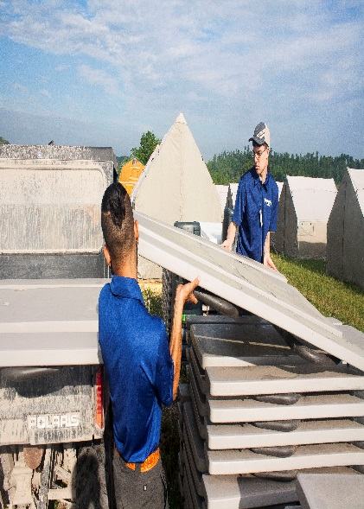
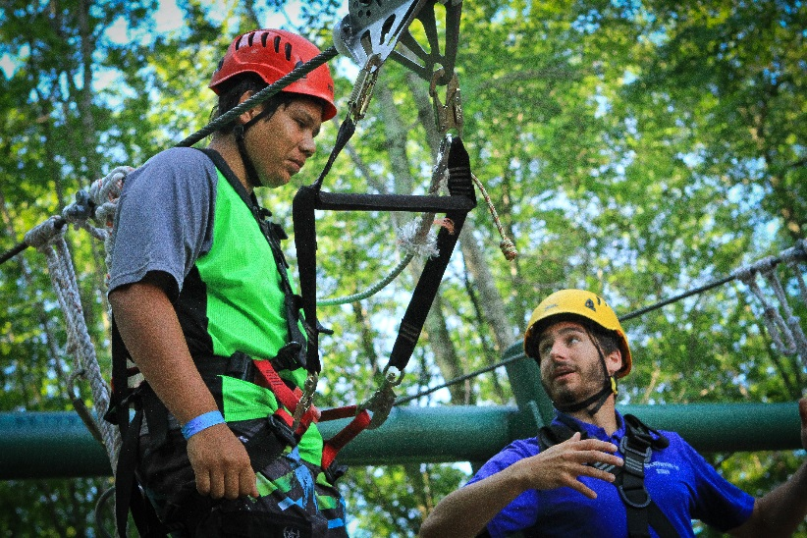
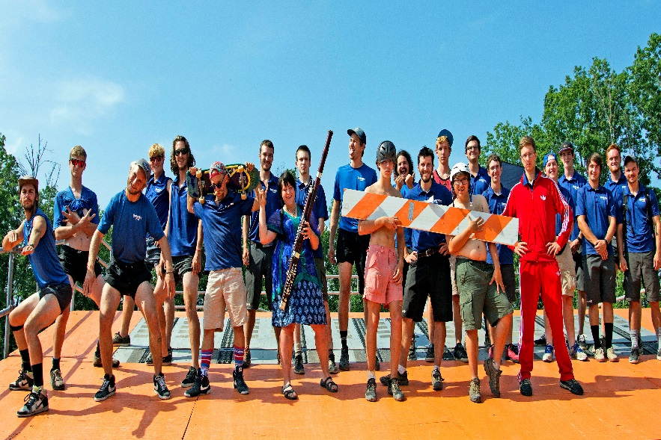
Summit Staff
Experienced Adult Instructors
Problem-Solving Support Staff
Education & Safety Oriented
Passionate In Their Fields
Fun To Be Around

Slide 16
Getting To The Summit Bechtel Reserve
Enter through South Gate near Mount Hope, WV
Follow signs for “Summit Bechtel Reserve” by exiting highway 19 at the North Beckley (highway 16) exit towards Bradley
Follow 16 for approximately 4 miles
Turn right onto highway 61 and follow for 2 miles
Summit Bechtel Reserve entrance will be on the left
Follow Jack Furst Drive for approximately 3 miles until you are greeted by staff at the south gate
If you are using GPS software, take care as it may take you to the incorrect gate (North utility entrance near Glen Jean, WV)

Slide 17
Getting to the James C. Justice National Scout Camp
Support Staff at the South Gate will direct you towards the Scott Visitor Center and the James C. Justice National Scout Camp
Follow Jack Furst Drive for 2.5 miles to the Scott Visitor Center for check in with Guest Services Staff
There you will meet your camp commissioner and continue for set up at the James C. Justice National Scout Camp

Slide 18
Summit Overview
James C. Justice National Scout Camp
Council Adventure Trek
Senior Scout Camp
Appalachian Adventure
Paul R. Christen National High Adventure Base
Summit Experience
Focused Program
Advanced Programs
Conservation Programs
John D. Tickle National Training & Leadership Center
7 Day Courses
5 Day Courses
3 Day Courses
National Scout Jamboree
10 Day Expo Event Every 4 Years

Slide 19
For More Information:
[Camp/Council Website]
[Council/Camp Name or Contact Person]
[Phone Number]
[email address]

